Slide 1
Responsive web design
by Stanislav Larionov

Slide 2
AGENDA
The responsive design (the mockups for each layout)
CSS rules for implementing each of those layouts
Media queries for conditionally applying those CSS rules

Slide 3
WHAT IS responsive web design?

Slide 4
INTRODUCTION
“Responsive design” refers to the idea that your website should display equally well in everything from widescreen monitors to mobile phones. It’s an approach to web design and development that eliminates the distinction between the mobile-friendly version of your website and its desktop counterpart. With responsive design, they’re the same thing.
Responsive design is accomplished through CSS “media queries”. Think of media queries as a way to conditionally apply CSS rules. They tell the browser that it should ignore or apply certain rules depending on the user’s device.

Slide 5
Responsive Web Design - Frameworks
Bootstrap
Foundation
Pure
Skeleton
Montage
Siimple
Gumby
Semantic UI

Slide 6
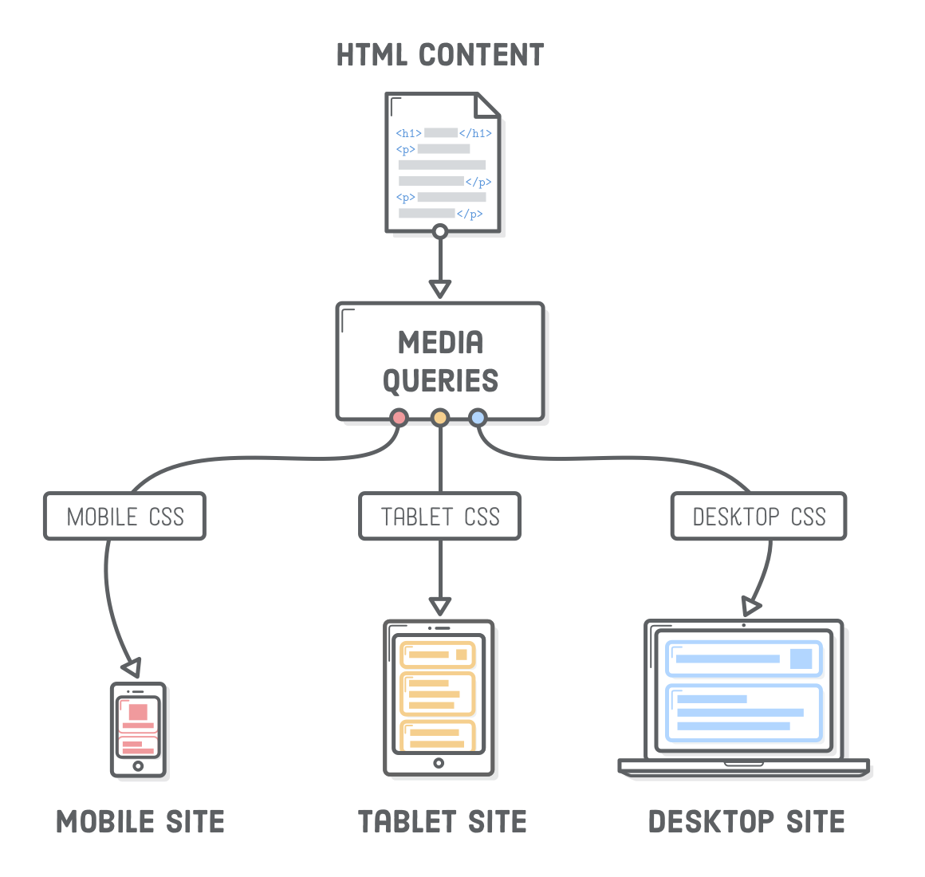
How responsive websites work

Slide 7
Media queries

Slide 8
Definition and Usage
The @media rule is used in media queries to apply different styles for different
media types/devices.
Media queries can be used to check many things, such as:
width and height of the viewport
width and height of the device
orientation (is the tablet/phone in landscape or portrait mode?)
resolution

Slide 9
CSS Syntax
@media not|only mediatype and (mediafeature and|or|not mediafeature) { CSS-Code;
}
<link rel="stylesheet" media="screen and (min-width: 900px)" href="widescreen.css"> <link rel="stylesheet" media="screen and (max-width: 600px)" href="smallscreen.css">
The logical operators not, and, and only can be used to compose a complex media query. You can also combine multiple media queries into a single rule by separating them with commas.

Slide 10
Logical operators
and | The and operator is used for combining multiple media features together into a single media query, requiring each chained feature to return true in order for the query to be true. It is also used for joining media features with media types.
not | The not operator is used to negate a media query, returning true if the query would otherwise return false. If present in a comma-separated list of queries, it will only negate the specific query to which it is applied. If you use the not operator, you must also specify a media type.
only | The only operator is used to apply a style only if an entire query matches, and is useful for preventing older browsers from applying selected styles. When not using only, older browsers would interpret the query screen and (max-width: 500px) simply as screen, ignoring the remainder of the query, and applying its styles on all screens. If you use the only operator, you must also specify a media type.

Slide 11
Logical operators
/* When the width is between 600px and 900px OR above 1100px - change the appearance of <div> */ @media screen and (max-width: 900px) and (min-width: 600px), (min-width: 1100px) { div.example { font-size: 50px; padding: 50px; border: 8px solid black; background: yellow; } }

Slide 12
Media Types and Features (Parameters)
Value | DESCRIPTION
all | Default. Used for all media type devices
print | Used for printers
screen | Used for computer screens, tablets, smart-phones etc.
speech | Used for screenreaders that "reads" the page out loud
Media Features

Slide 13
Responsive Image
<!DOCTYPE html>
<html>
<meta name="viewport" content="width=device-width, initial-scale=1.0">
<body>
<h2>Responsive Image</h2>
<img src="img_girl.jpg" style="max-width:100%;height:auto;">
</body>
</html>
Demo

Slide 14
Responsive Videos
<head>
<meta name="viewport" content="width=device-width, initial-scale=1.0">
<style>
video { max-width: 100%; height: auto; } </style>
</head>
<body>
<h2>Responsive video</h2>
<video width="400" controls><source src="mov_bbb.mp4" type="video/mp4"></video>
</body>
Demo

Slide 15
CSS rules
You can include as many CSS rules as you want in the media query.
body{ font-size: 14px;}
.button{ display: block;}
.title{ text-align: center;}
@media (min-width: 1200px) {
body{ font-size: 16px;}
.container{ margin: 0 auto; width: 960px;}
.button{ display: inline-block;}
.title{ text-align: left;}
}

Slide 16
CSS rules
/* Extra large devices (large laptops and desktops, 1200px and up) */
@media only screen and (min-width: 1200px) {
.example {background: pink;}
}
</style>
</head>
<body>
<h2>Typical Media Query Breakpoints</h2>
<p class="example">Resize the browser window to see how the background color of this paragraph changes on different screen sizes.</p>
</body>
</html>
<!DOCTYPE html>
<html>
<head>
<meta name="viewport" content="width=device-width, initial-scale=1.0">
<style>
.example {
padding: 20px;
color: white;
}
/* Extra small devices (phones, 600px and down) */
@media only screen and (max-width: 600px) {
.example {background: red;}
}
/* Small devices (portrait tablets and large phones, 600px and up) */
@media only screen and (min-width: 600px) {
.example {background: green;}
}
/* Medium devices (landscape tablets, 768px and up) */
@media only screen and (min-width: 768px) {
.example {background: blue;}
}
/* Large devices (laptops/desktops, 992px and up) */
@media only screen and (min-width: 992px) {
.example {background: orange;}
}

Slide 17
Setting The Viewport
HTML5 introduced a method to let web designers take control over the viewport,
through the <meta> tag.
<meta name="viewport" content="width=device-width, initial-scale=1.0">
A <meta> viewport element gives the browser instructions on how to control the page's dimensions and scaling.
The width=device-width part sets the width of the page to follow the screen-width of the device (which will vary depending on the device).
The initial-scale=1.0 part sets the initial zoom level when the page is first loaded by the browser.

Slide 18
Example
* {
margin: 0;
padding: 0;
box-sizing: border-box;
}
/* Mobile Styles */
@media only screen and (max-width: 400px) {
body {
background-color: #F09A9D; /* Red */
}
}
/* Tablet Styles */
@media only screen and (min-width: 401px) and (max-width: 960px) {
body {
background-color: #F5CF8E; /* Yellow */
}
}
/* Desktop Styles */
@media only screen and (min-width: 961px) {
body {
background-color: #B2D6FF; /* Blue */
}
}
body{ font-size: 14px;}
@media (min-width: 1200px) {
/* This part is only read by viewports wider than 1200 pixels */
body{ font-size: 16px;}
}
body{ font-size: 18px;}
@media (min-width: 1000px) and (orientation: landscape) {
body{ font-size: 20px;}
}

Slide 19
QUESTIONS ?

Slide 20
USED MATERIALS
https://developer.mozilla.org/en-US/docs/Web/CSS/Media_Queries/Using_media_queriesp
https://learn.shayhowe.com/advanced-html-css/responsive-web-design/
http://www.tutorialspoint.com/css/css_responsive.htm
https://marksheet.io/css-responsiveness.html
https://www.w3schools.com/html/html_responsive.asp

Slide 21
USEFUL LINKS
https://www.w3schools.com/cssref/css3_pr_mediaquery.asp
https://www.w3schools.com/html/tryit.asp?filename=tryhtml_responsive_image_maxwidth
https://www.w3schools.com/csS/css_rwd_templates.asp

Slide 22
THANK YOU

